Slide 1
Skylighting Web Application with three.js
Thesis Presentation by: John Zobolas
Supervisor: Georgios Papaioannou, Assistant Professor, AUEB

Slide 2
Outline
Why Skylight?
Skylight Models
An Analytic Model for Full Spectral Sky-Dome Radiance
Skylight Web application

Slide 3
Why skylight?
To build better model to use in:
Video games (instead of skyboxes): more natural and colorful images of the sky
Flight and driving simulations
Virtual worlds and even animated movies
Design/Architectural Applications (need for a proper Luminance model)
Astronomical Applications: NASA World Wind, Google Earth, Celestia, Space Engine

Slide 4
Skylight models: A brief history
Luminance-only Sky Models (Perez model, CIE Standard)
Sky Models that include Color Data (Nishita model, Preetham model, Hosek-Wilkie Sky Model, Physical-based models)
Night Sky models
Daylight simulation tools (e.g. Solene)

Slide 5
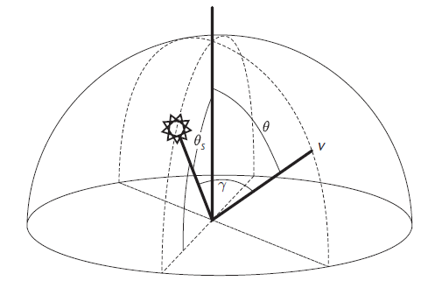
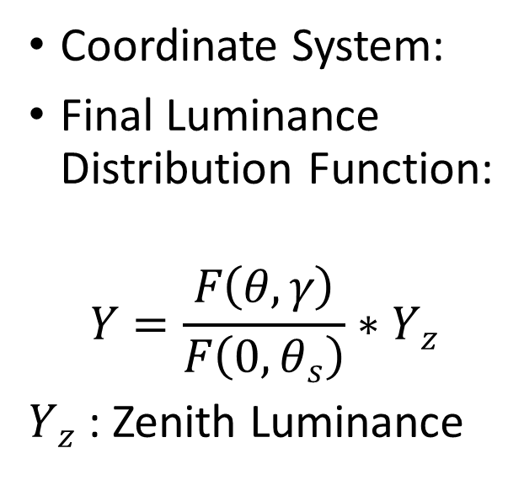
Perez Model (1993)
Calculates only Luminance on the Sky Dome
Best for clear skies with low turbidity
Use in Architecture and Lighting-design applications
Coordinate System:
Final Luminance Distribution Function:
$$Y=\frac{F\left(θ,γ\right)}{F\left(0,θ_{s}\right)}∗Y_{z}$$
$Y_{z}$ : Zenith Luminance

Slide 6
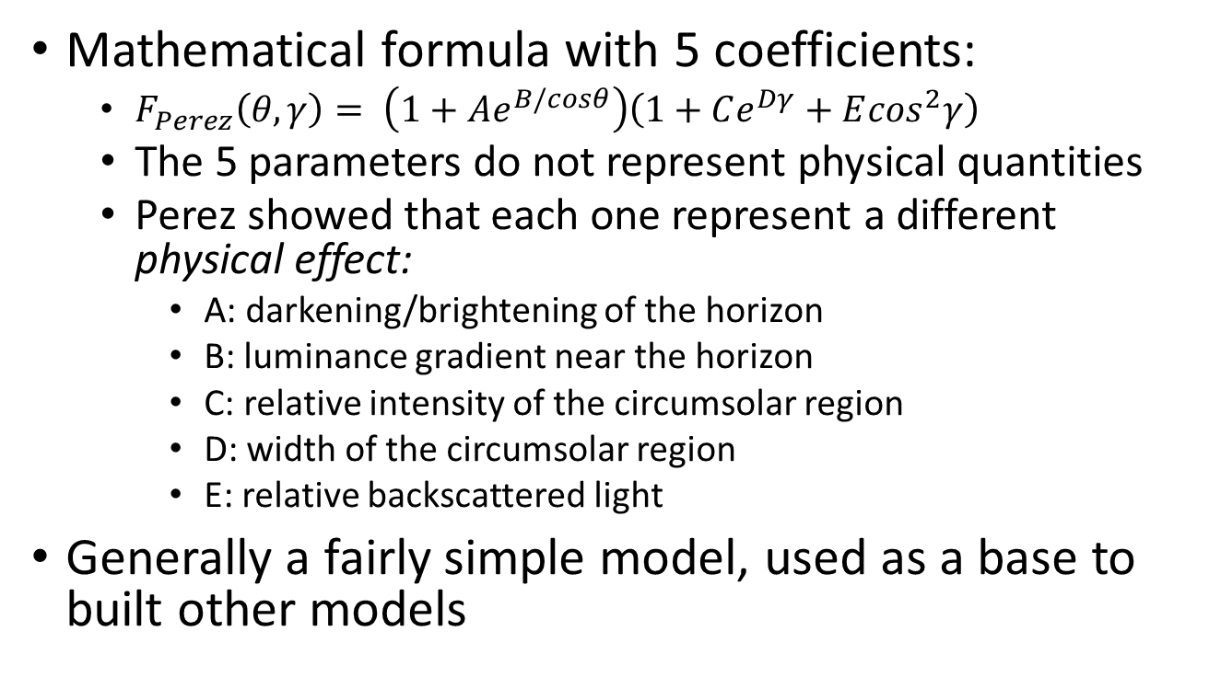
Perez model: mathematical framework
Mathematical formula with 5 coefficients:
$F_{Perez}\left(θ,γ\right)= \left(1+Ae^{B/cosθ}\right)\left(1+Ce^{Dγ}+E\cos^{2}γ\right)$
The 5 parameters do not represent physical quantities
Perez showed that each one represent a different physical effect:
A: darkening/brightening of the horizon
B: luminance gradient near the horizon
C: relative intensity of the circumsolar region
D: width of the circumsolar region
E: relative backscattered light
Generally a fairly simple model, used as a base to built other models

Slide 7
CIE Standard General Sky (2002)
CIE (Commission internationale de l'éclairage)
Perez’s model needed a lot of experimentation (5 coefficients) to get the luminance of a specific weather condition
Standard List of 16 models that describe luminance distributions (tabulated values for the 5 coefficients)
The models varied from clear cloudless sky to heavily overcast weather
Basis for the classification of measured sky luminance distributions
Useful for daylighting design applications

Slide 8
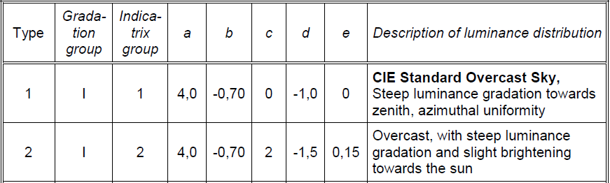
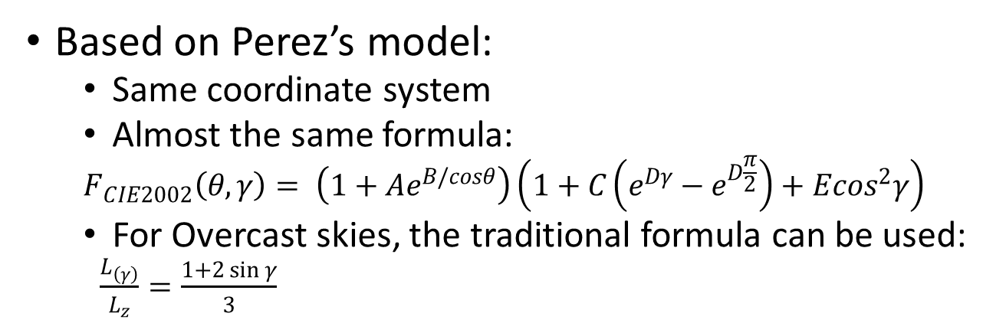
CIE Standard General Sky: mathematical framework
Based on Perez’s model:
Same coordinate system
Almost the same formula:
$$F_{CIE2002}\left(θ,γ\right)= \left(1+Ae^{B/cosθ}\right)\left(1+C\left(e^{Dγ}−e^{D\frac{π}{2}}\right)+E\cos^{2}γ\right)$$
For Overcast skies, the traditional formula can be used:
$\frac{L_{\left(γ\right)}}{L_{z}}=\frac{1+2\sin{γ}}{3}$
Example:

Slide 9
Nishita model (1993-1996)
The first physical-based model
1993 first model – single scattering, multiple scattering method in 1996 (revised model)
Used in space flight simulators or surveys of the earth
Emphasis on the red coloring of the horizon/color of the clouds and generally the atmospheric scattering that is caused by particles in the atmosphere
First analytical model for light scattering in the sea (water molecules)

Slide 10
Nishita model (1993-1996)
The 4 characteristics of the model:
Spectrum of the earth: direct sunlight from the Sun and attenuation/scattering in the atmosphere. Calculations used lookup tables and simplified from assumptions:
Sunlight is parallel
Shape of the Earth: a perfect sphere
Spectrum of the atmosphere: absorption/scattering due to particles in the atmosphere
Size, density distribution changing exponentially with altitude
Rayleigh Scattering (air molecules)
Mie scattering (dust, aerosols, etc.)
Spectrum on the surface of the sea: scattering light of water molecules and the reflected light at the surface
Color of the clouds: sunlight scattering from particles of the clouds

Slide 11
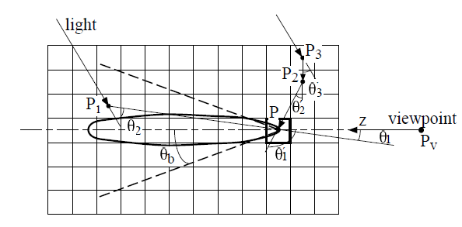
Nishita model (1996) – multiple scattering method
Subdivision of the space into space voxels
Calculate the energy transferred, absorbed and scattered between these voxels
Use of the well-known form factor from the radiosity models
Inside the clouds/atmosphere:
Mie scattering is the dominant scattering effect (water droplets)
Strong forward Mie scattering creates a lobe of space voxels that contribute more to the energy transfer/scattered towards the viewing point
Pre-compute the light scattering inside this sample space and use it afterwards as a reference for the calculations
Up until the 2rd order of path scattering
Simulations lasted 1-2 min without and ~2 hours with clouds

Slide 12
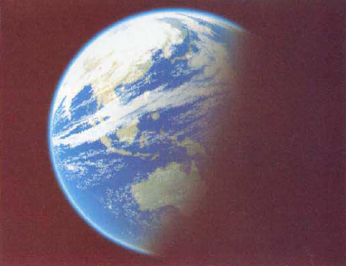
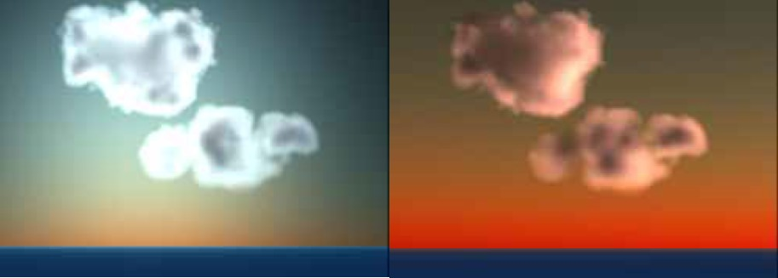
Nishita model - Results
Earth from space:
Clouds:

Slide 13
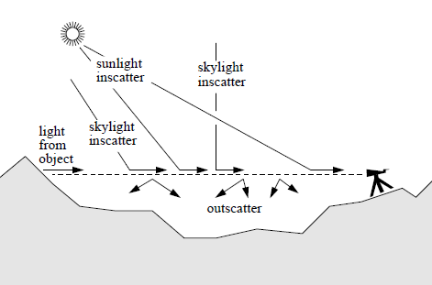
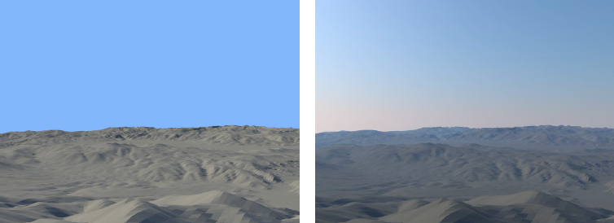
Preetham model (1999)
Need for a real-time rendering sky lighting model
Nishita’s model didn’t include the aerial perspective: the hue/shading effects of the color of the sky due to scattering and the desaturation and color shift of distant objects
Difference between images:

Slide 14
Preetham model (cont.)
The model should account for both spectral radiance of the Sun, sky and the aerial perspective
Must be easy and fast to use: a parametric model
Use Perez’s formula and compute A to E parameters analytically. Specifically:
Generate reference images/data using Nishita’s model and fit them to the equation (non-linear optimization)
Use only up to 2nd order of scattering (includes Rayleigh and Mie scattering)
The coefficients become linear functions of turbidity and the solar elevation
Solutions are provided in two chroma channels (x, y) and the model provides way to convert to spectral-radiance data

Slide 15
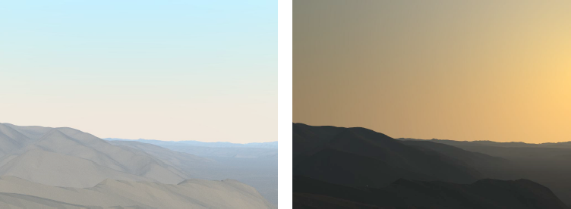
Preetham model - Results
Example of high turbidity images $\left(T=6\right)$:
Afternoon
Near Sunset

Slide 16
Preetham model with SH Lighting
Spherical Harmonic (SH) Lighting techniques
Family of real-time rendering techniques
Produce highly realistic shading and shadowing with comparatively little overhead
Replacing parts of standard lighting equations with spherical functions (spherical harmonics as a basis)
Compute the SH weights as polynomial functions of the skylight model (Preetham) parameters:
Sun’s azimuth value
Turbidity
Do a polynomial two-dimensional non-linear least squares fit for the principal parameters:
achieve both negligible memory and computation costs
minimizing the mean reconstruction error
Gibbs phenomena suppression to remove ringing artifacts (on the hemisphere’s horizon)

Slide 17
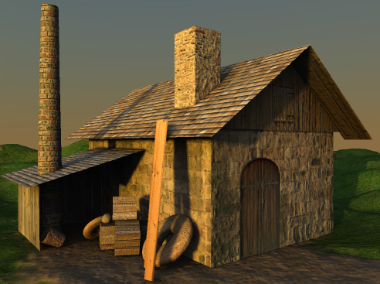
Preetham model with SH Lighting Simulation Demo with Scene

Slide 18
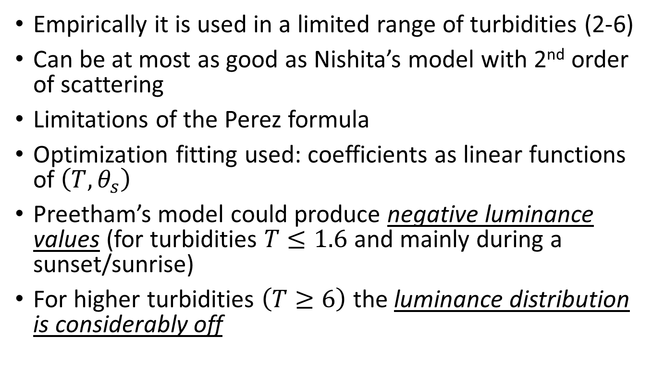
Preetham model: problems
Empirically it is used in a limited range of turbidities (2-6)
Can be at most as good as Nishita’s model with 2nd order of scattering
Limitations of the Perez formula
Optimization fitting used: coefficients as linear functions of $\left(T,θ_{s}\right)$
Preetham’s model could produce negative luminance values (for turbidities $T≤1.6$ and mainly during a sunset/sunrise)
For higher turbidities $\left(T≥6\right)$ the luminance distribution is considerably off

Slide 19
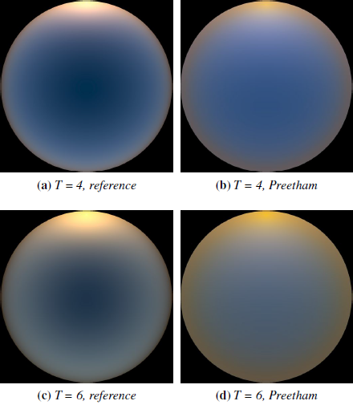
Comparison of Preetham’s model with reference image from path tracer at sunrise

Slide 20
Physical-based models
Based on Physics laws: size/density of particles in the atmosphere, atmospheric layers, dependent on the weather conditions, humidity etc.
Try to solve lighting equations using certain techniques like pre-computation
Full spectral radiance models
More realistic results – more complex models
Just like Nishita’s Model – they could be used as a base to build a more complete parametric model than Preetham’s

Slide 21
Physically-based simulation of twilight phenomena (2005)
The authors state that in order to simulate the beautiful colors of the twilight sky, you need to take into account:
solar irradiance spectrum and its absorption in the ozone layer
wavelength-dependent refraction of direct sunlight in the atmosphere
climate-dependent composition and size distribution of aerosols / dust particles
height-dependent air, humidity, and aerosol density
Rayleigh scattering (air molecules) and Mie scattering (aerosols)
radiative transfer (high-order multiple scattering)
The shadow of the Earth

Slide 22
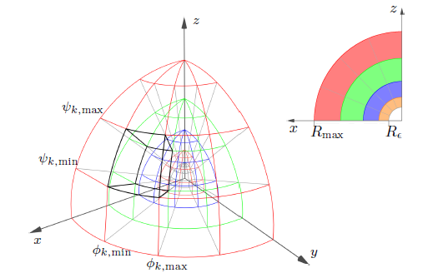
Physically-based simulation of twilight phenomena (cont.)
5-step computational process for arbitrary observer:
Position of the Sun
Setup the optical and wavelength-dependent parameters of the atmosphere model (with OPAC software)
Direct illumination (Sun)
Refraction
Ozone layer
Earth’s shadow
Indirect illumination
simulate multiple scattering events between the cells
use approximations
optimized volume radiosity algorithm
Convert illuminated atmosphere into RGB sky texture

Slide 23
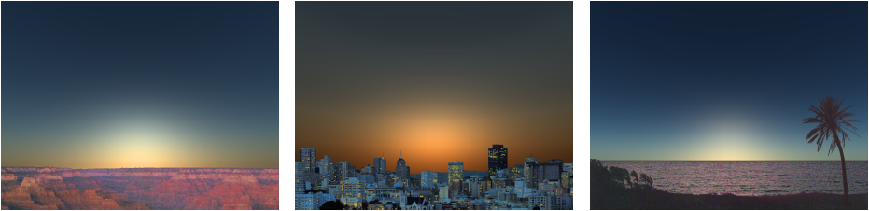
Physically-based simulation of twilight phenomena
Simulation time: ∼2 hours
Multiple scattering with five scattering events
Sky radiances with less than 1% maximum error
Model does not include ground albedo or clouds
Different climate conditions:

Slide 24
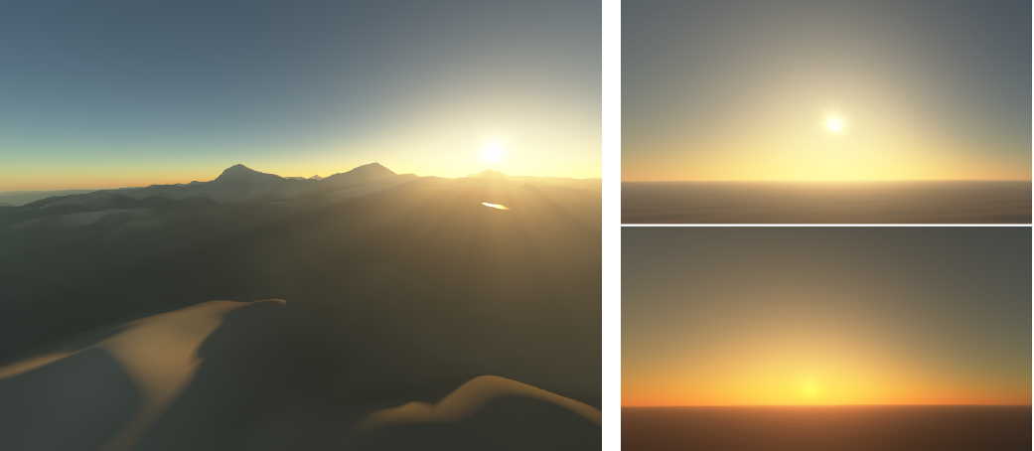
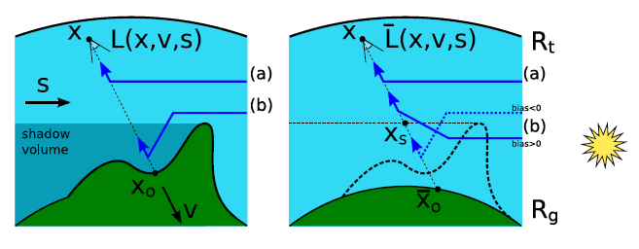
Bruneton’s model (2008)
Includes ground albedo
Rayleigh and Mie multiple scattering
Renders mountain’s shadows and light shafts
Exact computation for zero and single scattering
Incremental approximated calculation of higher scattering orders (until 5th order)
Algorithm ignores occlusion effects
Implementation is GPU-based (5 seconds for total calculations)
Applicable for any viewpoint from ground to space
Results:

Slide 25
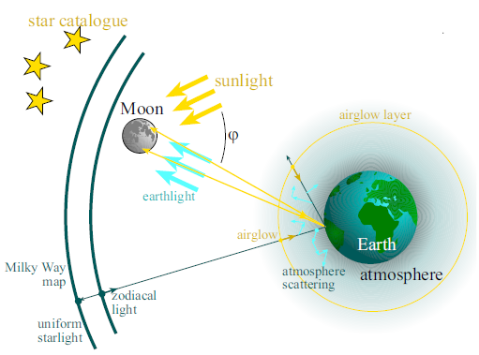
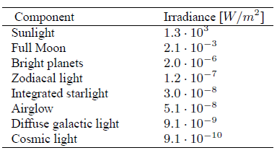
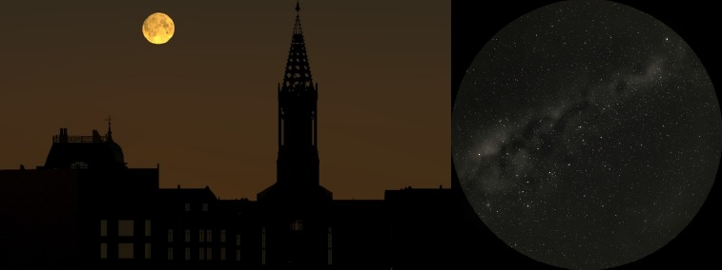
Night Sky model (2001)
All light sources from a night sky:
astronomical data for the calculations
multiple scattering in the atmosphere (Nishita’s model – 2nd scattering order)
Rendering time: 30secs - 2min
Model:
The “impression of night”: use a perceptually based tone-mapping algorithm after running the Monte-Carlo ray tracer

Slide 26
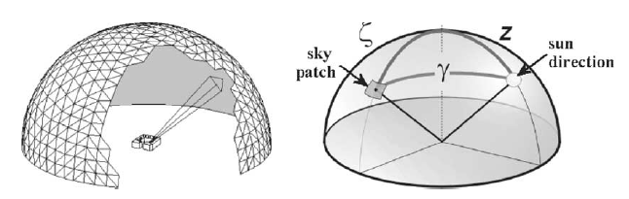
Solene: a Daylight Simulation Tool
Simulating sunshine, lighting and thermal radiation on urban territories/morphologies and indoor architectural spaces
Same approach for indoors and outdoors
Support for multiple glazing/transparent surfaces
No restrictions on the input geometry
No limited sky conditions (CIE): use of Perez formula
Triangulation of sky dome into patches:

Slide 27
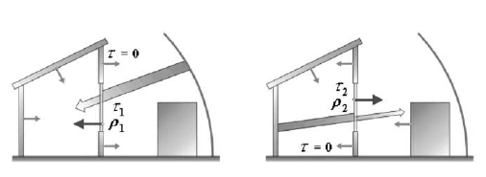
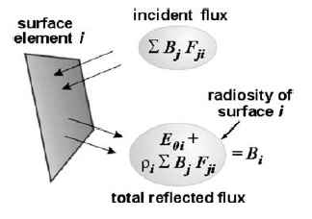
Solene’s luminance model
Divide the scene also into patches and sum the luminance of all sky patches that are visible to every one
Calculate luminance of “invisible” areas:
by reflected light from other surfaces
Patches are small enough (constant received and reflected energy)
No re-emission to the sky
Surfaces are opaque and Lambertian
Radiosity model: every patch exchanges luminous energy with other patch (use of a hidden surface removal process)
Glazing areas not as new diffuse light sources but acting both as:
normal opaque patches
transparent surfaces (transmission factor – different for each side)
Multi-reflections can be calculated analytically

Slide 28
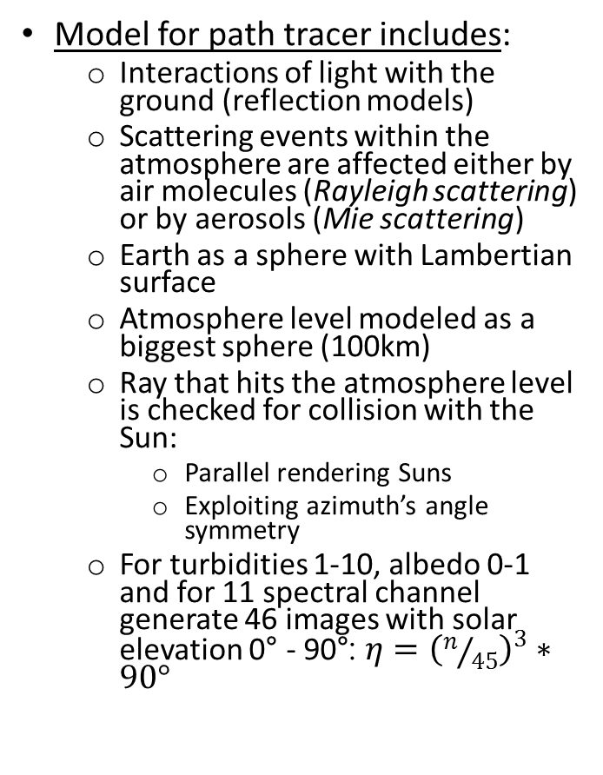
An Analytic Model for Full Spectral Sky-Dome Radiance (2012)
Full-spectral (including the UV range)
Includes effect of ground albedo
For viewers at the surface of the earth
Parametric – based on Perez’s mathematical formula and Preetham’s fitting to radiance data
Implement a path tracer that simulates brute force simulation of radiative transfer in the atmosphere
Rays with no scattering were excluded – no solar disk (optimization stability – better parametric fitting to the dataset)
Simulations can last 40min to 3hours
Model for path tracer includes:
Interactions of light with the ground (reflection models)
Scattering events within the atmosphere are affected either by air molecules (Rayleigh scattering) or by aerosols (Mie scattering)
Earth as a sphere with Lambertian surface
Atmosphere level modeled as a biggest sphere (100km)
Ray that hits the atmosphere level is checked for collision with the Sun:
Parallel rendering Suns
Exploiting azimuth’s angle symmetry
For turbidities 1-10, albedo 0-1 and for 11 spectral channel generate 46 images with solar elevation 0° - 90°: ${η=\left(n/{45}\right)}^{3}∗90°$

Slide 29
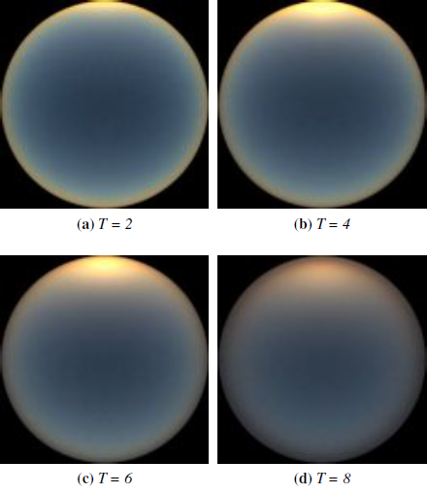
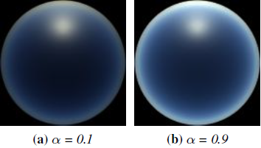
Hosek-Wilkie model: Path tracer results
Different turbidities:
Importance on the
Simulation of sunset colors
The effect of ground albedo

Slide 30
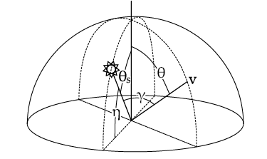
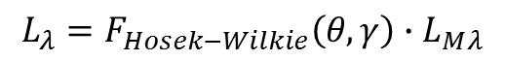
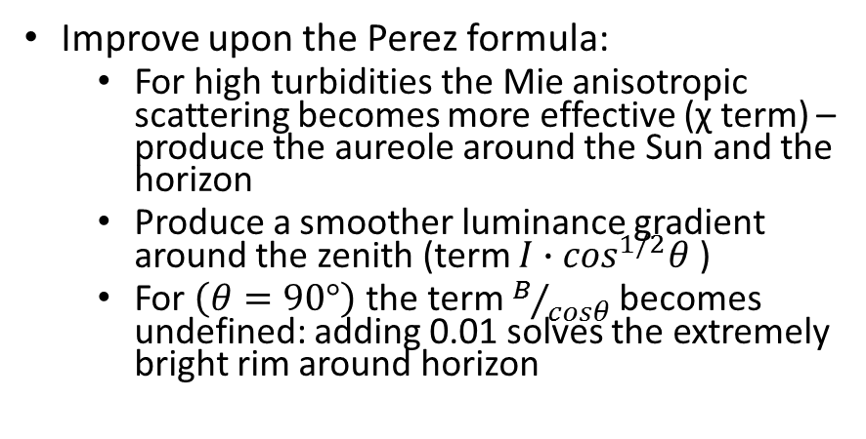
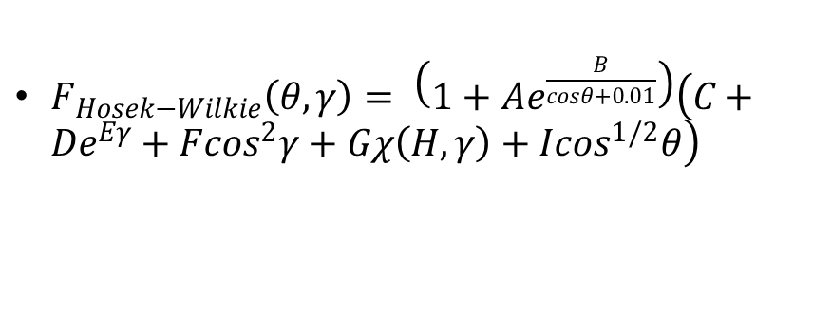
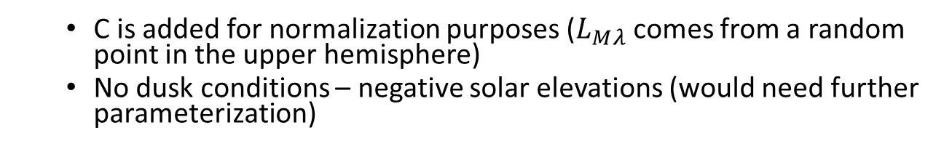
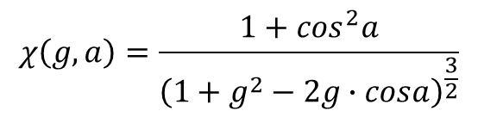
Hosek-Wilkie mathematical framework
$F_{Hosek−Wilkie}\left(θ,γ\right)= \left(1+Ae^{\frac{B}{cosθ+0.01}}\right)\left(C+De^{Eγ}+F\cos^{2}γ+Gχ\left(Η,γ\right)+Ι\cos^{1/2}θ\right)$
$$L_{λ}=F_{Hosek−Wilkie}\left(θ,γ\right)∙L_{Μλ}$$
Improve upon the Perez formula:
For high turbidities the Mie anisotropic scattering becomes more effective (χ term) – produce the aureole around the Sun and the horizon
Produce a smoother luminance gradient around the zenith (term $I∙\cos^{1/2}θ$ )
For $\left(θ=90°\right)$ the term $B/{cosθ}$ becomes undefined: adding 0.01 solves the extremely bright rim around horizon
$$χ\left(g,a\right)=\frac{1+\cos^{2}a}{{\left(1+g^{2}−2g∙cosa\right)}^{\frac{3}{2}}}$$
C is added for normalization purposes ($L_{Μλ}$ comes from a random point in the upper hemisphere)
No dusk conditions – negative solar elevations (would need further parameterization)

Slide 31
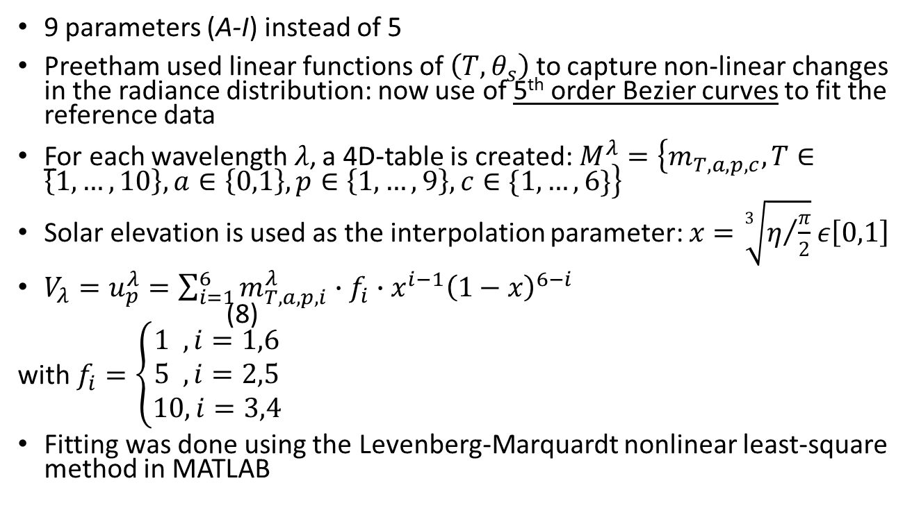
Hosek-Wilkie model: calculating the parameters
9 parameters (A-I) instead of 5
Preetham used linear functions of $\left(T,θ_{s}\right)$ to capture non-linear changes in the radiance distribution: now use of 5th order Bezier curves to fit the reference data
For each wavelength$λ$, a 4D-table is created:$M^{λ}=\left\{m_{T,a,p,c},T∈\left\{1,…,10\right\},a∈\left\{0,1\right\},p∈\left\{1,…,9\right\},c∈\{1,…,6\}\right\}$
Solar elevation is used as the interpolation parameter: $x=\sqrt[3]{η/{\frac{π}{2}}}$ $ε\left[0,1\right]$
${V_{λ}=u}_{p}^{λ}=\sum_{i=1}^{6}{m_{T,a,p,i}^{λ}∙f_{i}∙x^{i−1}{\left(1−x\right)}^{6−i}}$ (8)
with $f_{i}=\left\{\begin{aligned}1 ,i=1,6 \\ 5 ,i=2,5 \\ 10,i=3,4\end{aligned}\right.$
Fitting was done using the Levenberg-Marquardt nonlinear least-square method in MATLAB

Slide 32
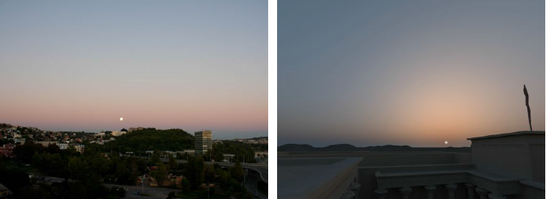
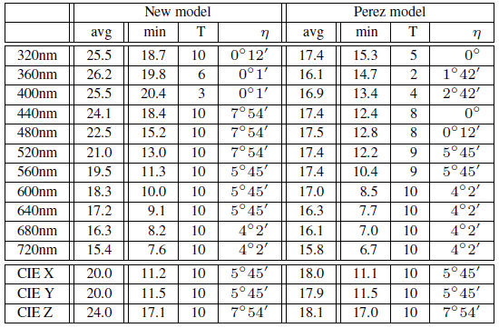
Hosek-Wilkie model Sky Radiance Results
Hosek-Wilkie and Perez’s model vs Path tracer Reference data
Real photo vs Simulation results for turbidity 9

Slide 33
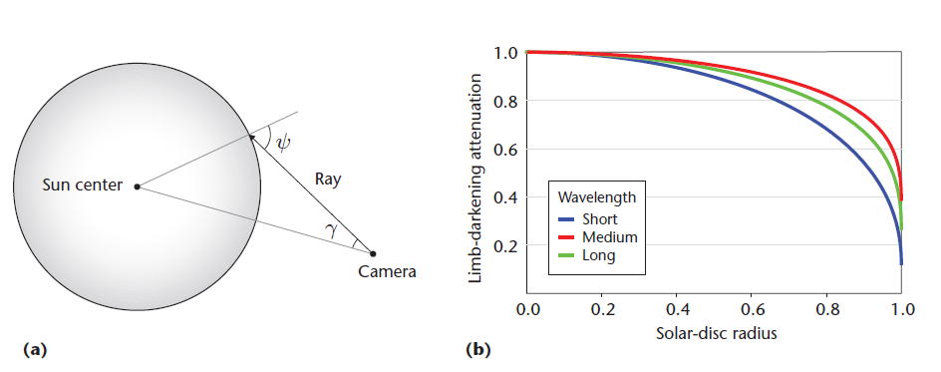
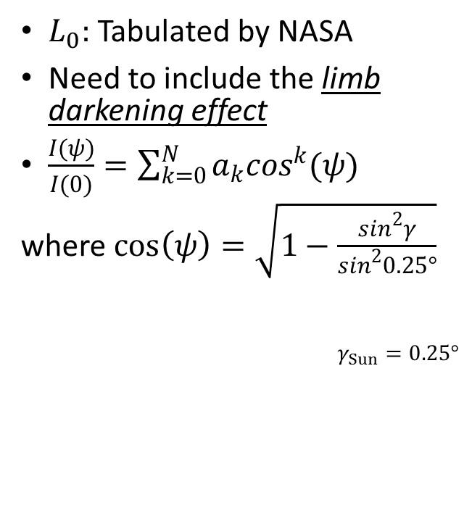
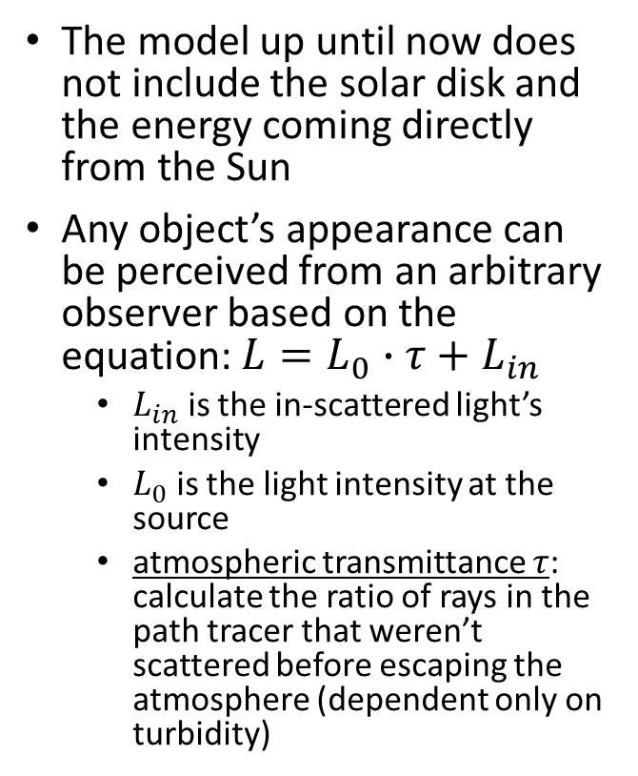
Hosek-Wilkie model: adding a solar Radiance function (2013)
The model up until now does not include the solar disk and the energy coming directly from the Sun
Any object’s appearance can be perceived from an arbitrary observer based on the equation: $L=L_{0}∙τ+L_{in}$
$L_{in}$ is the in-scattered light’s intensity
$L_{0}$ is the light intensity at the source
atmospheric transmittance $τ$: calculate the ratio of rays in the path tracer that weren’t scattered before escaping the atmosphere (dependent only on turbidity)
$L_{0}:$ Tabulated by NASA
Need to include the limb darkening effect
$\frac{I(ψ)}{Ι(0)}=\sum_{k=0}^{N}{a_{k}\cos^{k}(ψ)}$
where $\cos\left(ψ\right)=\sqrt{1−\frac{\sin^{2}γ}{\sin^{2}0.25°}}$
$γ_{Sun}=0.25°$

Slide 34
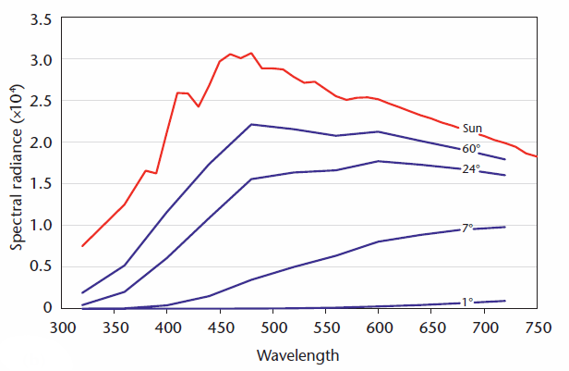
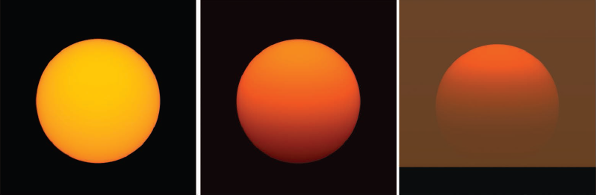
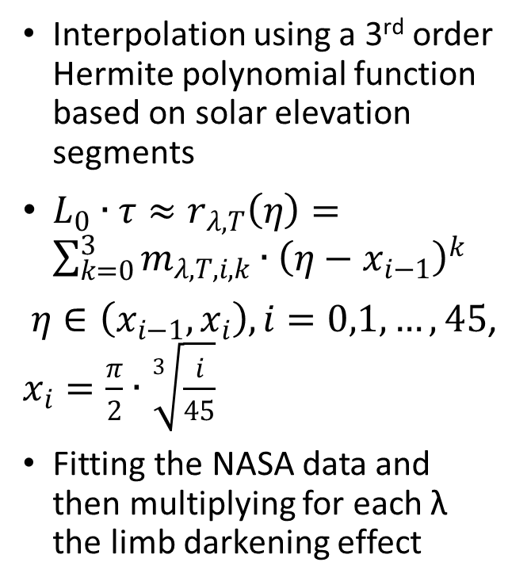
Hosek-Wilkie model: calculating the solar radiance and results
Interpolation using a 3rd order Hermite polynomial function based on solar elevation segments
$L_{0}∙τ≈r_{λ,Τ}\left(η\right)=\sum_{k=0}^{3}{m_{λ,Τ,i,k}∙{\left(η−x_{i−1}\right)}^{k}}$
$η∈\left(x_{i−1},x_{i}\right), i=0,1,…,45$, $x_{i}=\frac{π}{2}∙\sqrt[3]{\frac{i}{45}}$
Fitting the NASA data and then multiplying for each λ the limb darkening effect
T=4

Slide 35
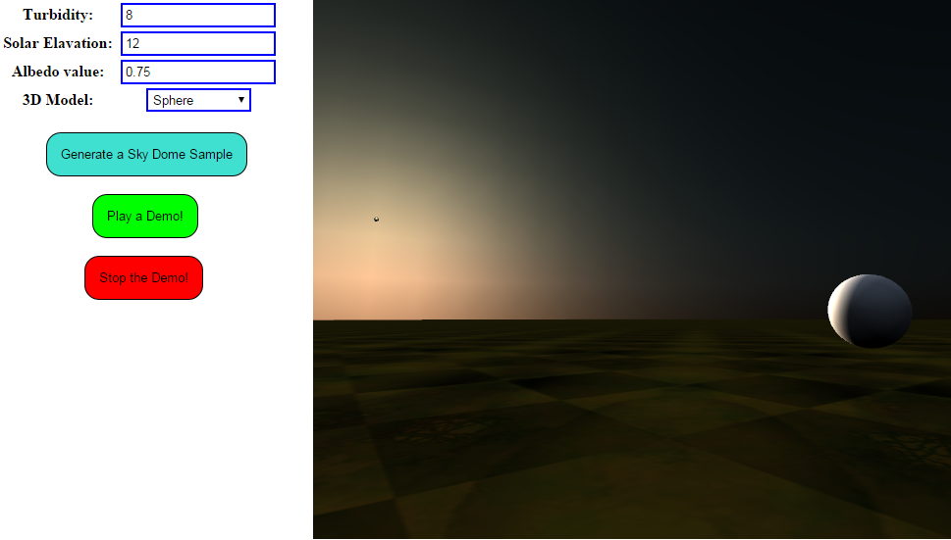
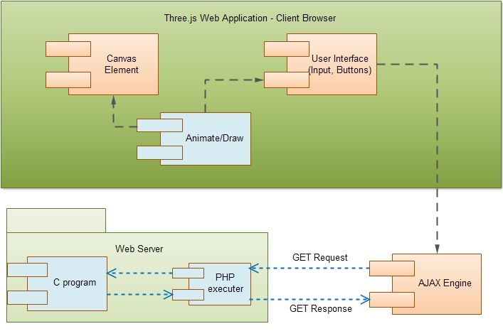
SkyLight Web Application
Architecture component diagram
Web GUI
Three.js 3D Library
Use of Hosek-Wilkie model implementation in C: generate dome geometry, color values, lights

Slide 36
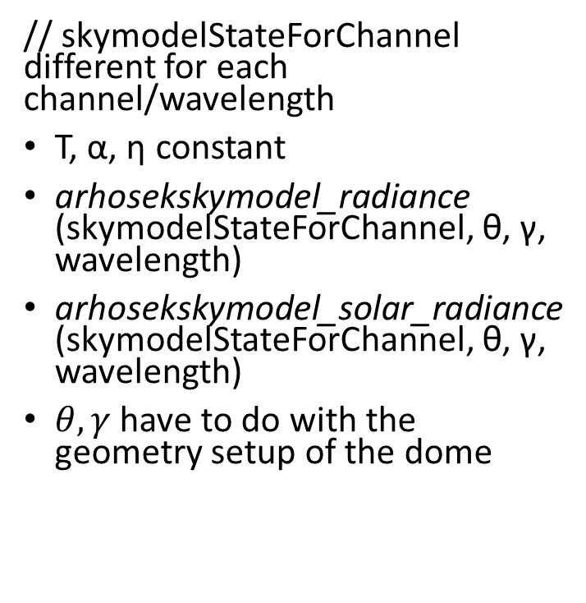
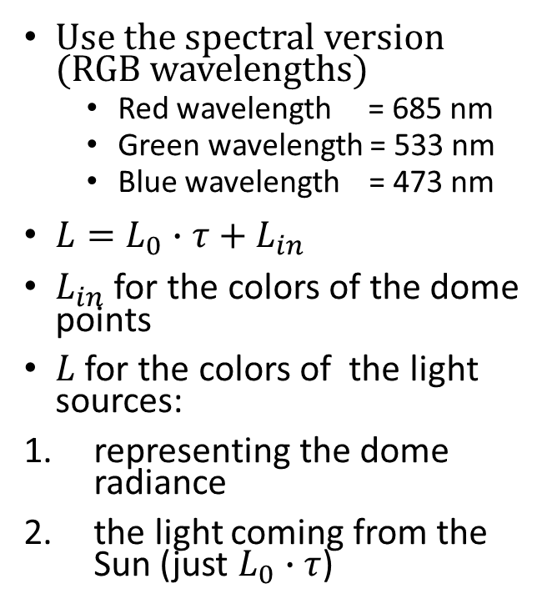
Using the Hosek-Wilkie model
Use the spectral version (RGB wavelengths)
Red wavelength = 685 nm
Green wavelength = 533 nm
Blue wavelength = 473 nm
$L=L_{0}∙τ+L_{in}$
$L_{in}$ for the colors of the dome points
$L$ for the colors of the light sources:
representing the dome radiance
the light coming from the Sun (just $L_{0}∙τ$)
// skymodelStateForChannel different for each channel/wavelength
Τ, α, η constant
arhosekskymodel_radiance (skymodelStateForChannel, θ, γ, wavelength)
arhosekskymodel_solar_radiance (skymodelStateForChannel, θ, γ, wavelength)
$θ,γ$ have to do with the geometry setup of the dome

Slide 37
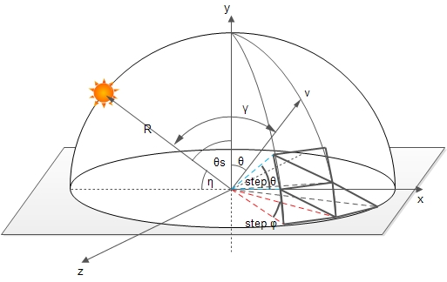
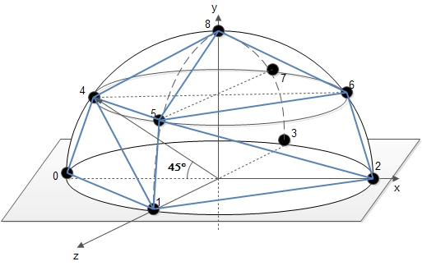
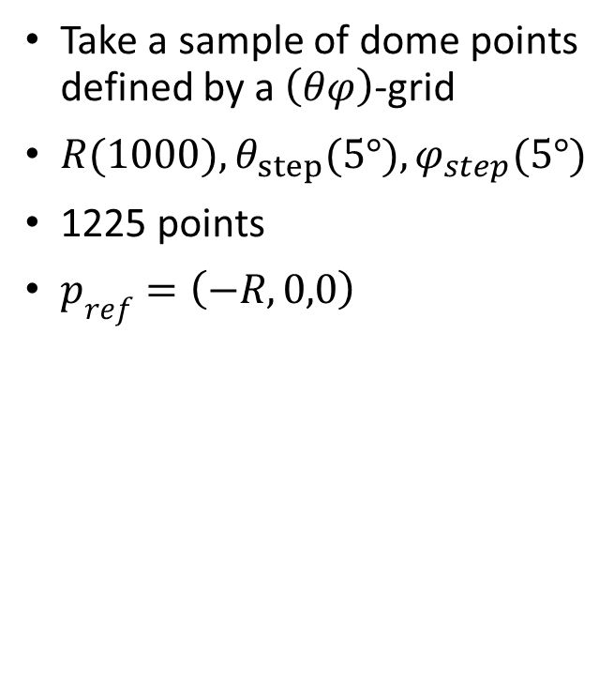
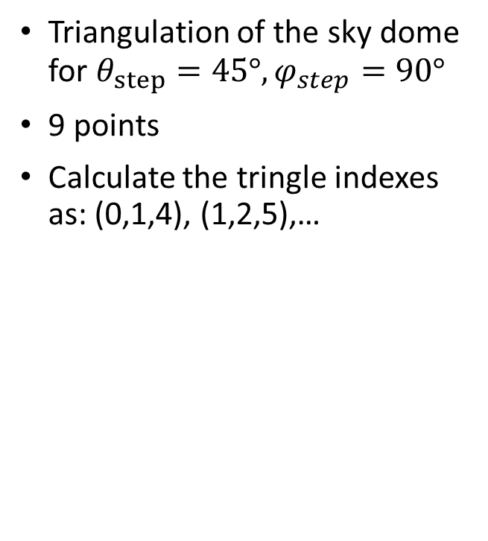
Building the sky-dome
Take a sample of dome points defined by a $\left(θφ\right)$-grid
$R(1000), θ_{step}(5°),φ_{step}(5°)$
1225 points
$p_{ref}=\left(−R,0,0\right)$
Triangulation of the sky dome for $θ_{step}=45°,φ_{step}=90°$
9 points
Calculate the tringle indexes as: (0,1,4), (1,2,5),…

Slide 38





Adding the lights to our scene
$L_{SkyDome}(Τ,α,η)=\iint_{Ω}{Ldω}=\int_{φ=0}^{2π}{\int_{θ=0}^{\frac{π}{2}}{L(θ,γ,Τ,α,η)dθdφ}}$
$L_{SkyDome}(Τ,α,η)=\iint_{Ω}{Ldω}≈\frac{2π}{N}\sum_{i=1}^{N=5}{L_{i}}$
$L_{in}^{new}={\frac{2π}{N}∗L}_{in}$
$L_{0}∙τ≫L_{in}^{new}$ : calculate sunToDomeSurfaceRatio (STDR)
$δ=2∙arctan\left(r/R\right)⇒r=R∙tan\left(δ/2\right)$
$\frac{{Surface}_{Sun}}{{Surface}_{SkyDome}}=\frac{πr^{2}}{2πR^{2}}=1.0927∙{10}^{−5}$
${\left(L_{0}∙τ\right)}^{new}=STDR∗\left(L_{0}∙τ\right)$
$δ_{Sun}={32}^{′}=0.5357°$.

Slide 39
Three.js implementation
Three.js provides an easy to use API
Camera movement
Color mapping (dome and Sun’s light)
Buffer Geometry for the triangulated dome
Sun as a sphere
Ground texture
5 point lights (not supporting shadows) – 2x intensity for the sunlight
3d models (json vs collada models)

Slide 40
Thanks!
Demo time…

